Slide 1


Assalamualikum

Slide 2

Project: Block ToDo
Course: CSE-1122
Team Members-
Tamizullah Kabbo (C233263)
Tawsif Ahemd (C233261)
Shahriar Kabir (C233194)
Tasbir Ahmed (C233265)
Submitted to-
Mohammad Shahin Uddin
Lecturer, Adjunct Faculty
Dept. of CSE, IIUC

Slide 3

Introduction
BlockToDo is a user-friendly task manager that helps you boost productivity by organizing your day into blocks of focused time. With real-time tracking and a simple interface, it's designed to unblock your productivity and make you more efficient in daily life.

Slide 4
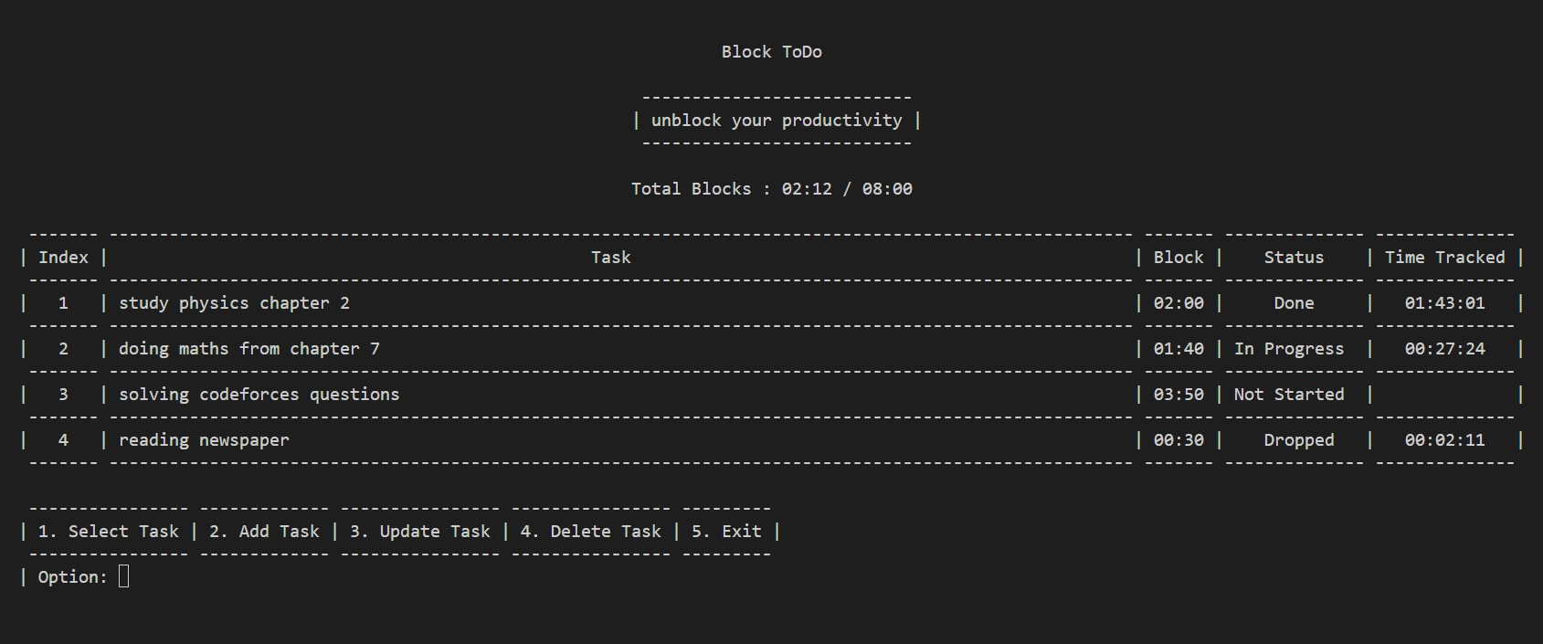
Features
User-Friendly Interface:
Intuitive and easy-to-use interface for seamless task management.

Slide 5
Features
Task Details & Time Efficiency Insights:
Include details for each task, such as title, block duration, and current status.

Slide 6
Features
Task Details & Time Efficiency Insights:
Provide insights into how effectively time is utilized.

Slide 7
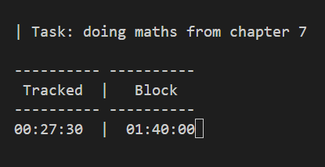
Features
Timer & Real-Time Time Tracking:
Includes a timer for each task within the time block.
Track the time spent on each task in real-time.

Slide 8
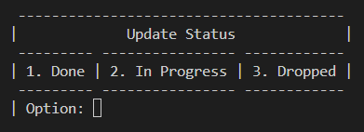
Features
Status Updates:
Set and update the status of tasks (In Progress, Done, Dropped).

Slide 9
Features
Total Block Indicator:
Displays the total blocks used against the available time.

Slide 10
Features
Task Editing:
Edit task details, including title, block, and status.
Task Deletion:
Delete individual tasks or clear all tasks.
Persistence:
Save task data locally to persist across application launches.

Slide 11
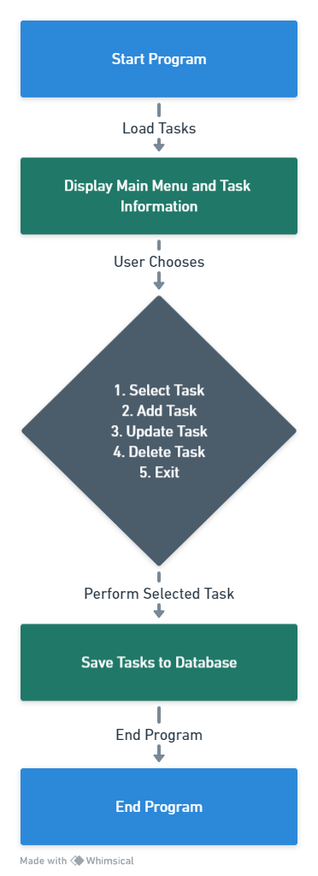
Implementation
Short Description & Flowchart:
The Block ToDo application, implemented in C, is a console-based task management system. Users can add, track, and update tasks with associated time blocks. The program utilizes standard C libraries for input/output, string manipulation, and time handling. Users interact with a menu-driven interface, where they can select, add, update, or delete tasks. A timer feature allows tracking time spent on a task. The code manages tasks using an array of structures, saving and loading data from a local file. The application emphasizes simplicity and productivity, making it a straightforward tool for users seeking an uncomplicated task management solution.

Slide 12
Implementation
Library Used:
stdio.h: Standard Input/Output functions for reading and writing.
stdlib.h: Standard Library functions for memory allocation, conversion, and other utility functions.
string.h: String manipulation functions.
.
conio.h (Windows-specific): Used a function for handling time in milliseconds
windows.h (Windows-specific): Windows API functions for controlling the console.
unistd.h (Mac/Linux-specific): Standard symbolic constants and types.

Slide 13
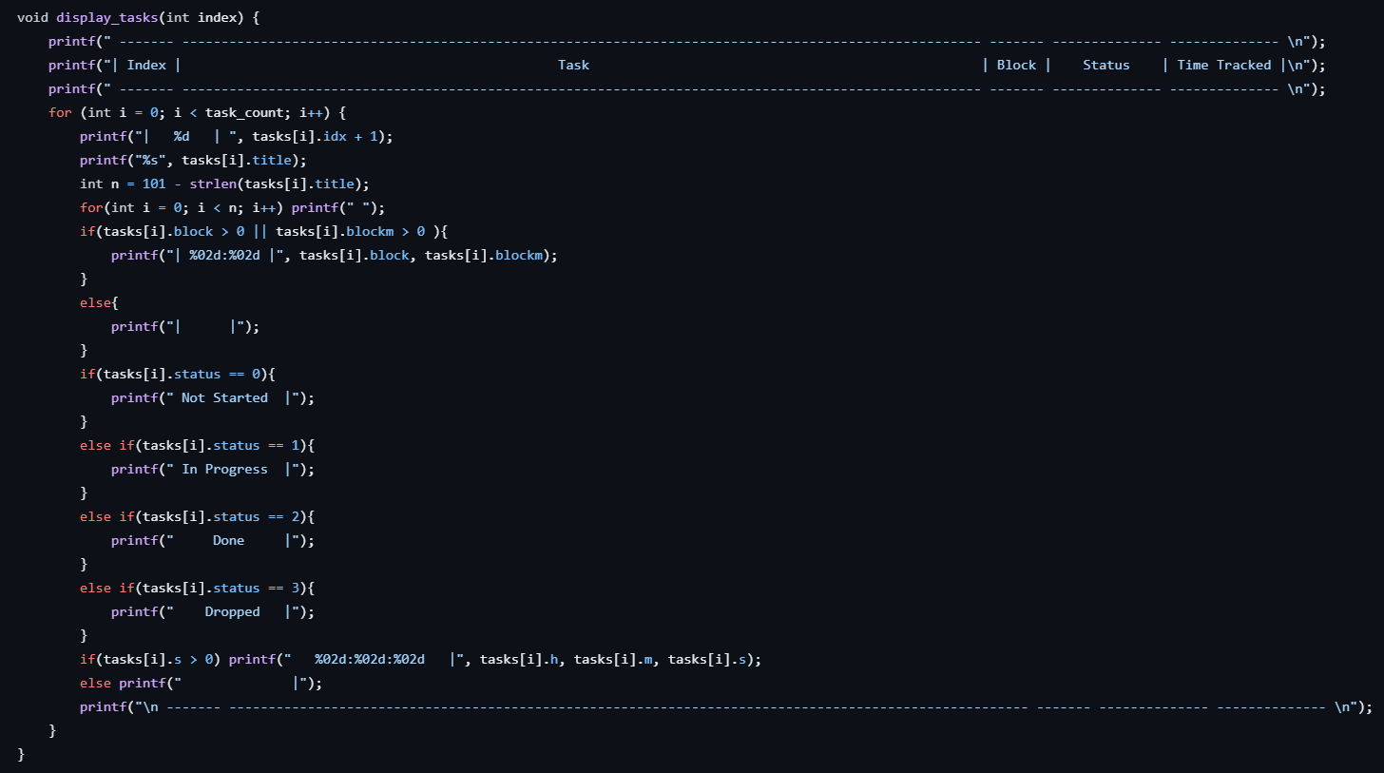
Implementation
Function Used:
We tried to replicate the modern rendering technic called component based rendering using functions.

Slide 14
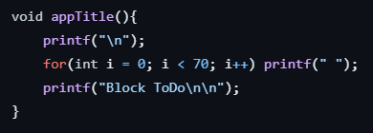
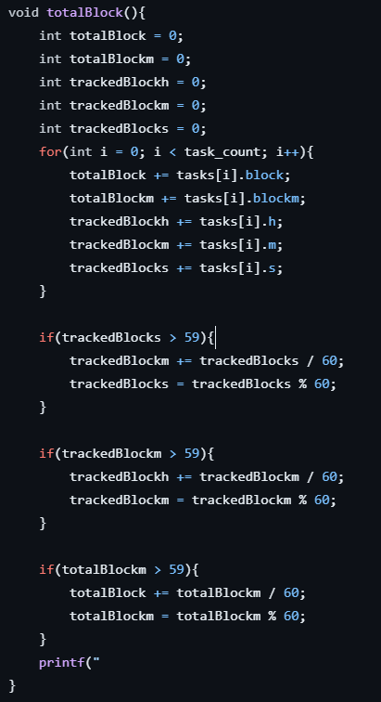
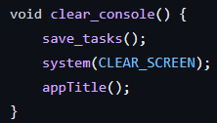
Implementation
Function Used:
We tried to replicate the modern rendering technic called component based rendering using functions.

Slide 15

Future Scope
There are many aspects of improvement we can do to our app in near future such as - Integrating log in system, notification system, enhanced UI, various platform versions (Android, iOS, Windows, MacOS) and lastly include machine learning to optimize the tasks and time etc. The possibilities are endless.

Slide 16
Conclusion
In summary, BlockToDo is a promising task management application that brings simplicity and efficiency to daily planning. Overall our app will make its user more productive and efficient on their everyday tasks. And our plan is to make BlockToDo helpful for you in more ways, keeping things simple and easy.
Source Code:
https://github.com/kabbotalukder/CSE-1122-Project

Slide 17
“Let’s go invent tomorrow
instead of worrying about
what happened yesterday.”
– Steve Jobs

Slide 18
Thank You

